Slide 1
IMDB Movie Analysis
Presented by: Mannat Sandhu
https://docs.google.com/spreadsheets/d/17zNQNlSCzDOxygvln4fwFVpOMiDvF-YQ/edit?usp=drive_link&ouid=101663467761144856859&rtpof=true&sd=true

Slide 2
Introduction
We are provided with the dataset related to IMDB Movies.
The dataset is significant for movie producers, directors, and investors who want to understand what makes a movie successful to make informed decisions in their future projects.
The success can be defined by high IMDB ratings/scores.

Slide 3
Five 'Whys' Approach
Why do we need high imdb score?
To identify high performing movies.
Why we need to identify high performing movies?
To identify best directors.
Why we need best directors?
To increase the no of viewers.
Why we need to increase the viewers?
To increase the profit margin.
Why we need high profit margin?
To attract the investors.

Slide 4

Tech-Stack Used
In this project the tech stack used is “Microsoft excel”, to clean and analyze the data to solve the given problems.

Slide 5
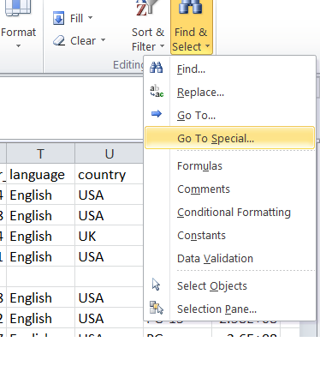
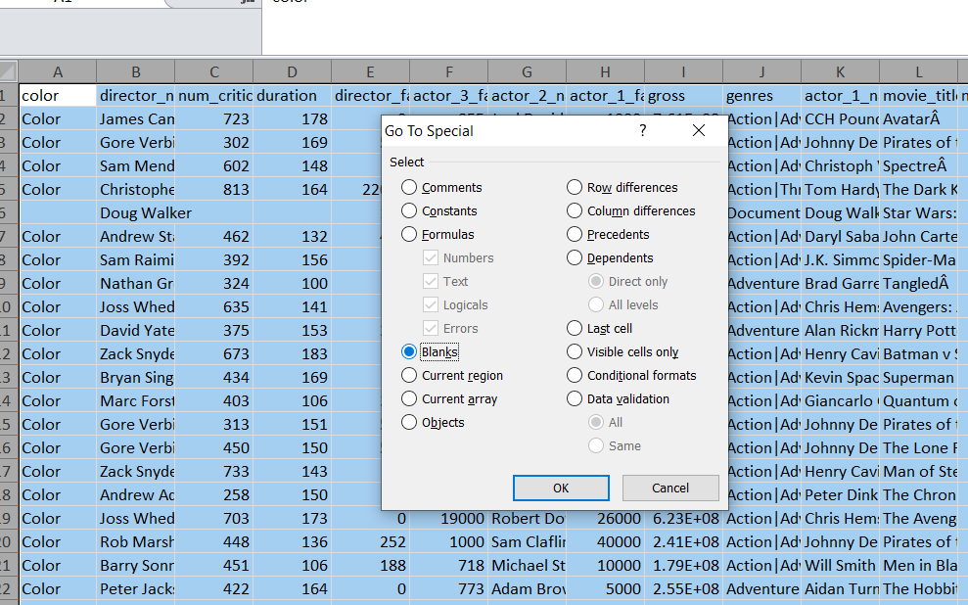
Approach
On downloading the dataset, we started preparing the data for analysis.
First the blanks in the data are removed:

Slide 6
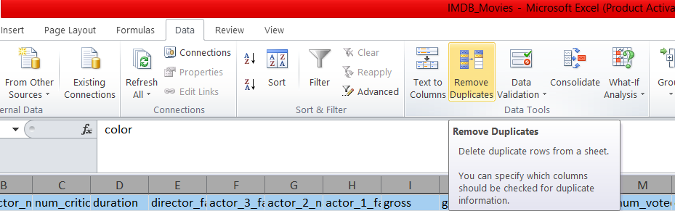
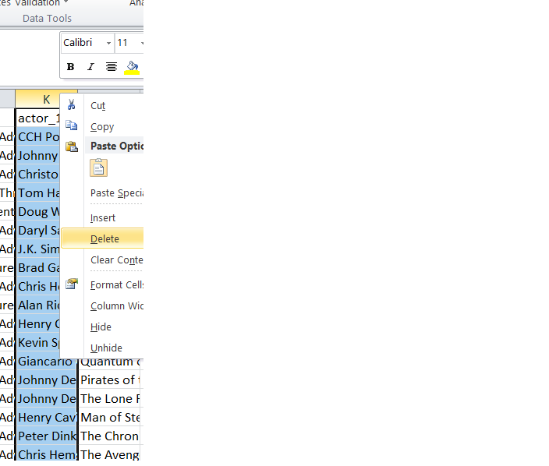
On deleting the highlighted blanks, we will now remove the duplicates:
And now we will remove the unnecessary columns:

Slide 7
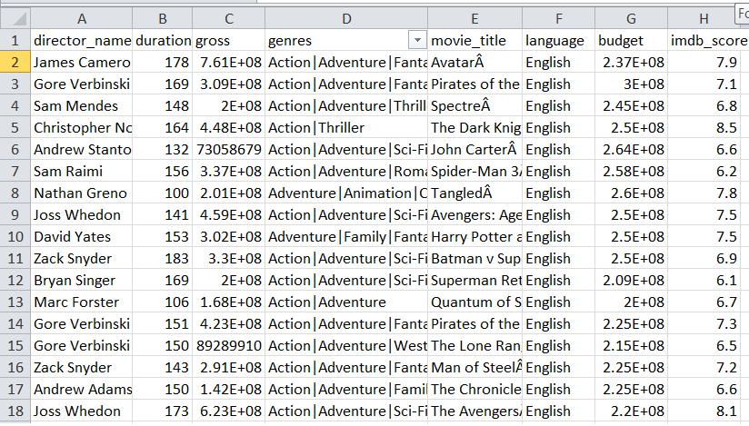
On completion of above steps we will get the following clean data for analysis with 8 columns and 3657 rows.

Slide 8
Data Analytics Tasks:
Movie Genre Analysis
Movie Duration Analysis
Language Analysis
Director Analysis
Budget Analysis

Slide 9
Movie Genre Analysis
The task is to determine the most common genres and calculate descriptive statistics of the IMDB scores.
For this I have broadly categorized the genres to 17 categories from the first beginning with genre.
For the following categories I have calculated count, mean, median, mode, max, min, variance and standard deviation of imdb score using following functions:

Slide 10
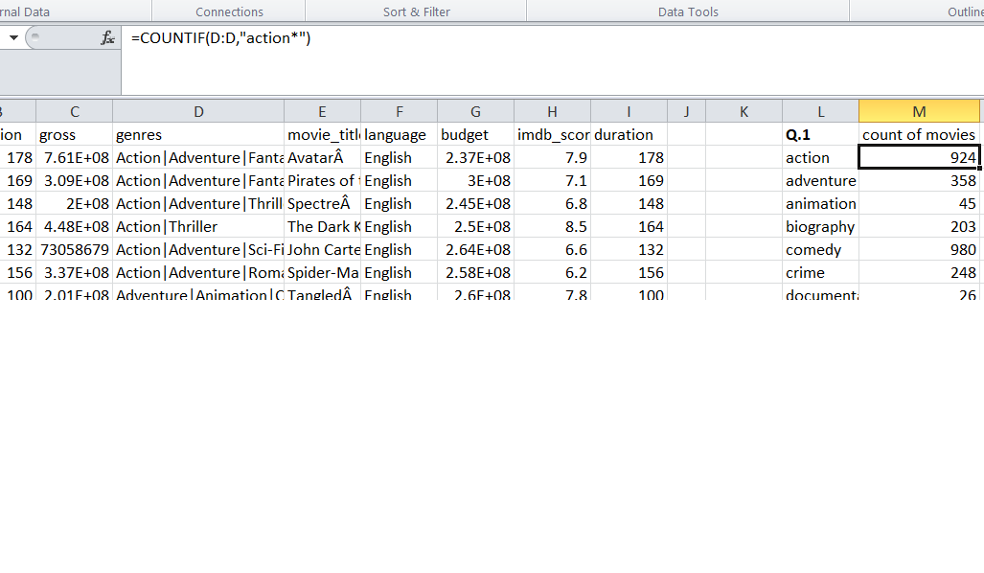
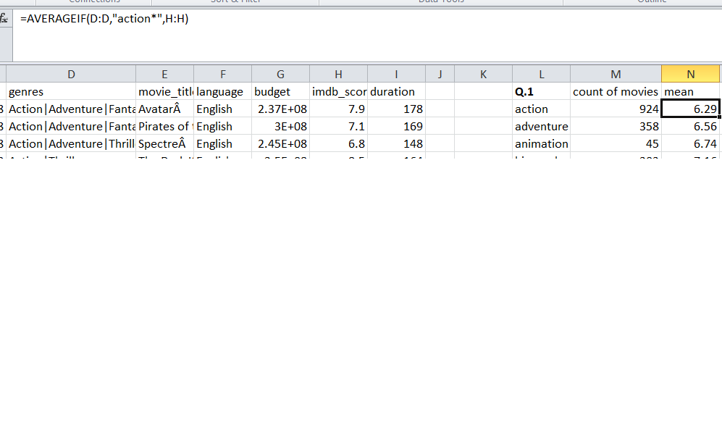
As only countif and averageif supports the wildcard entries, for rest of the calculations I will use the filter function with aggregate to achieve results.

Slide 11
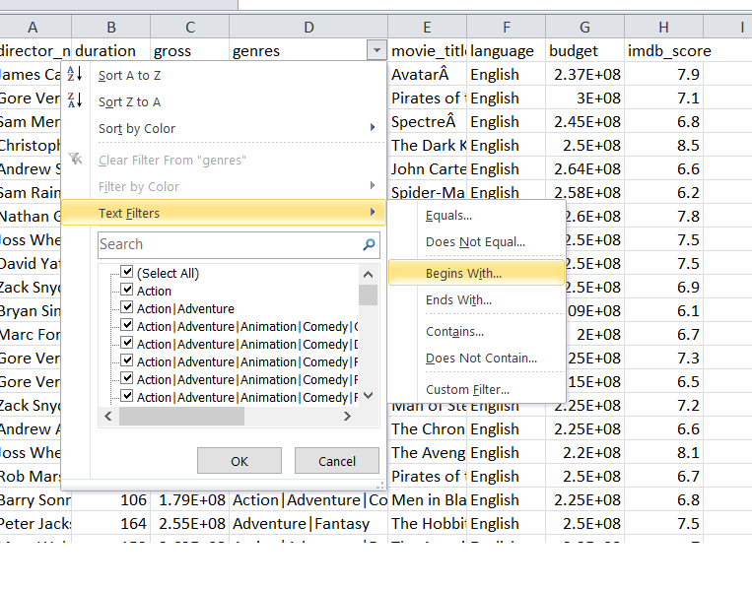
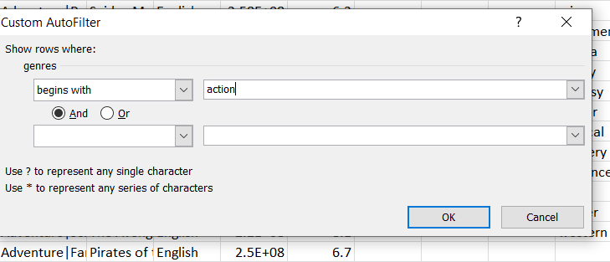
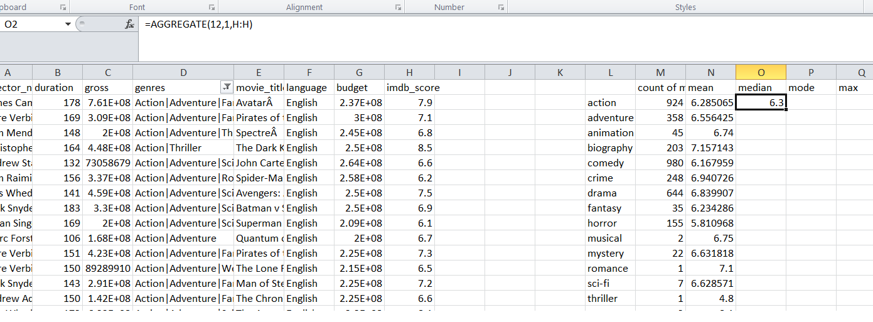

Slide 12
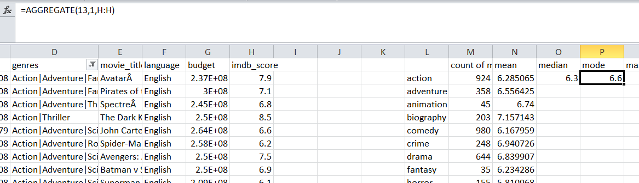
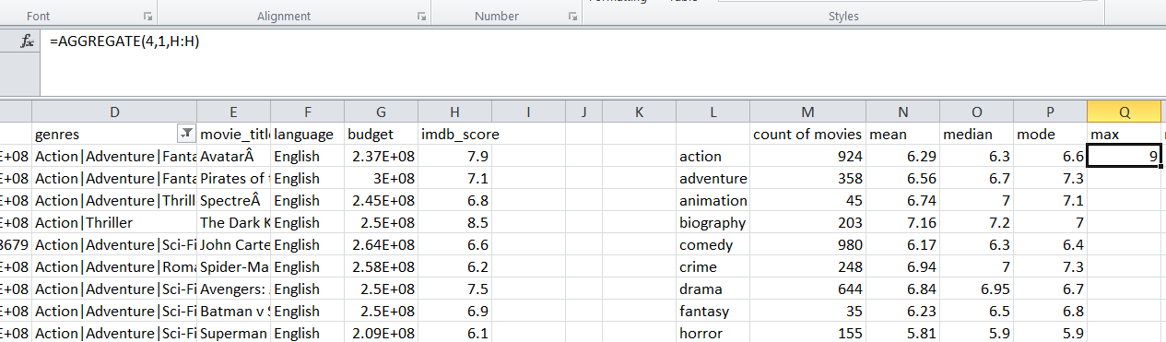
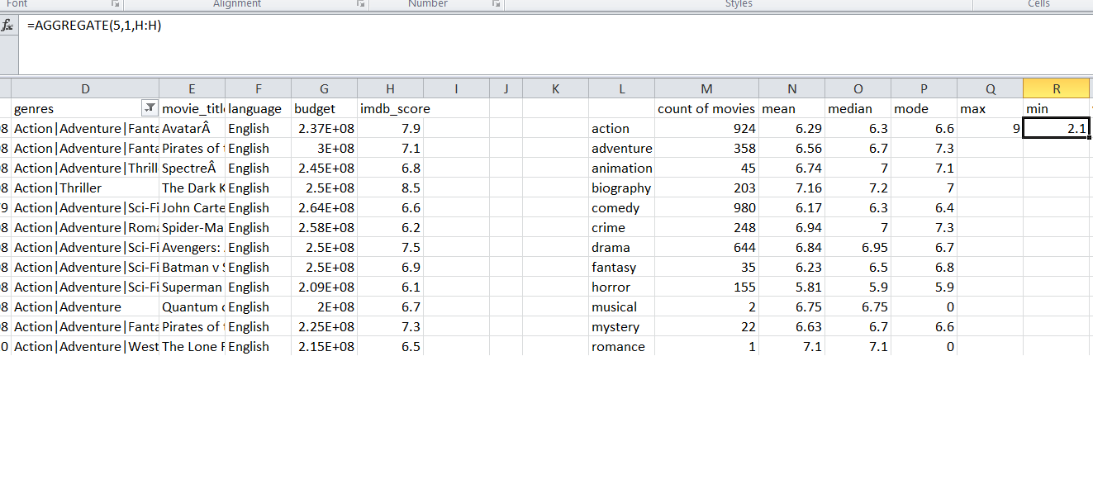

Slide 13
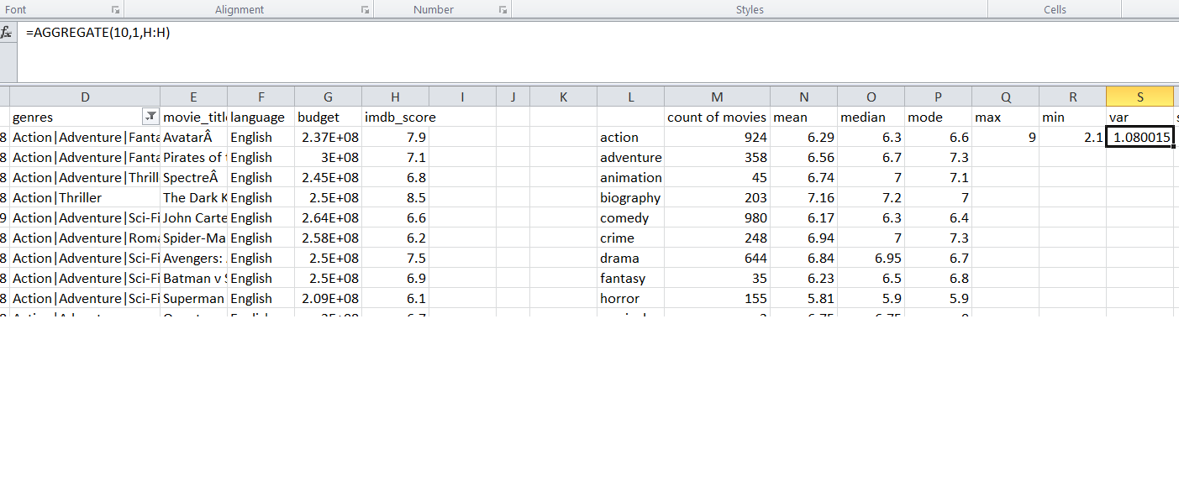
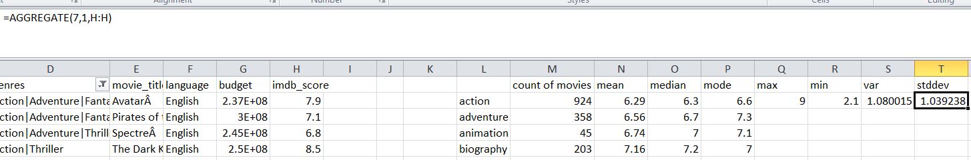
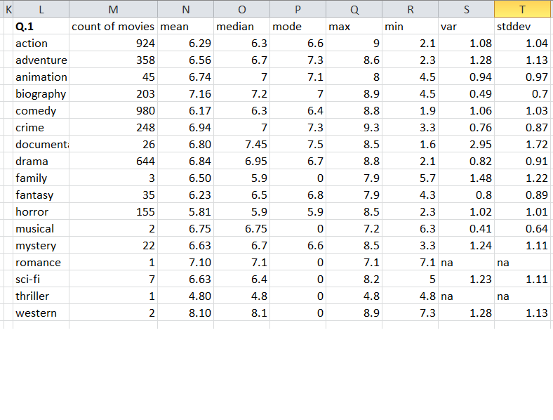

Slide 14
Movie Duration Analysis
The task is to determine distribution of movie durations and identify the relationship between movie duration and IMDB score.
To achieve the desired results I have first obtained the unique durations for movies using the advanced filter function.

Slide 15
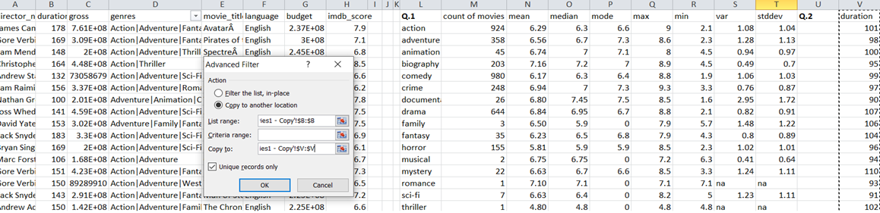
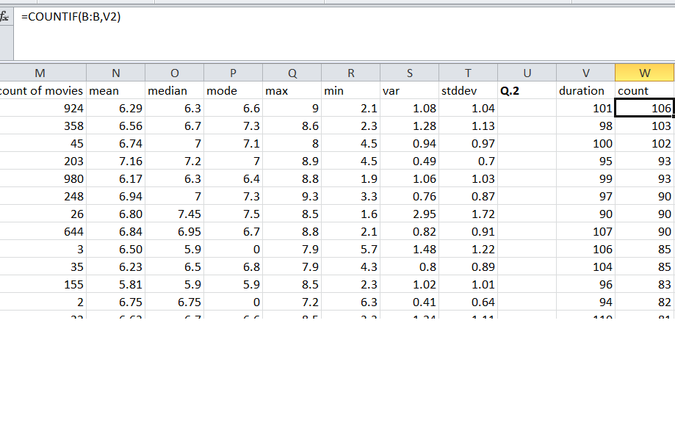
On getting the unique duration values, I will count the no of movies for each duration.

Slide 16
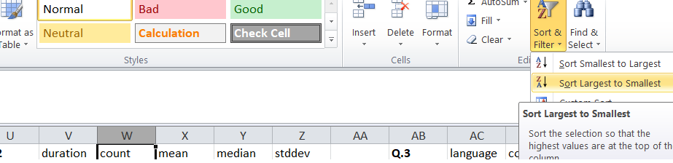
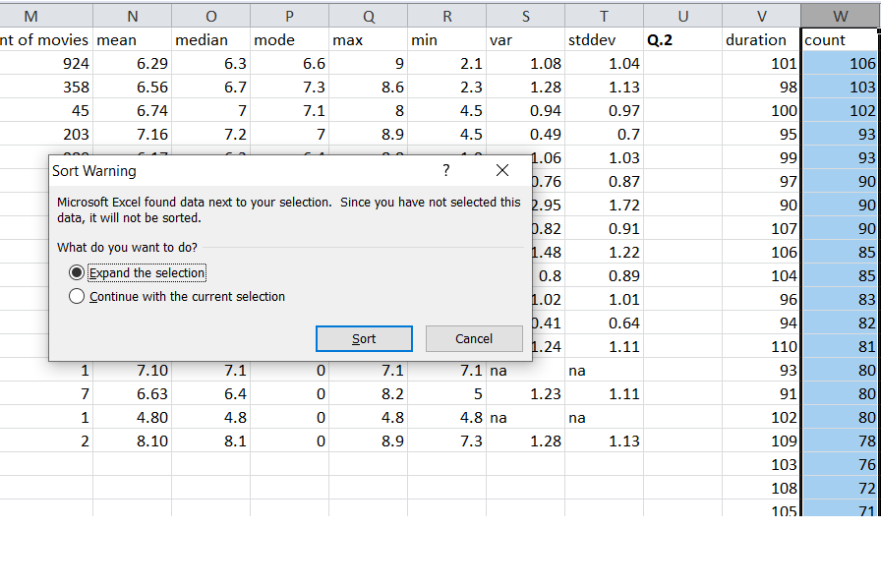
Now I will sort the values from largest to smallest.

Slide 17
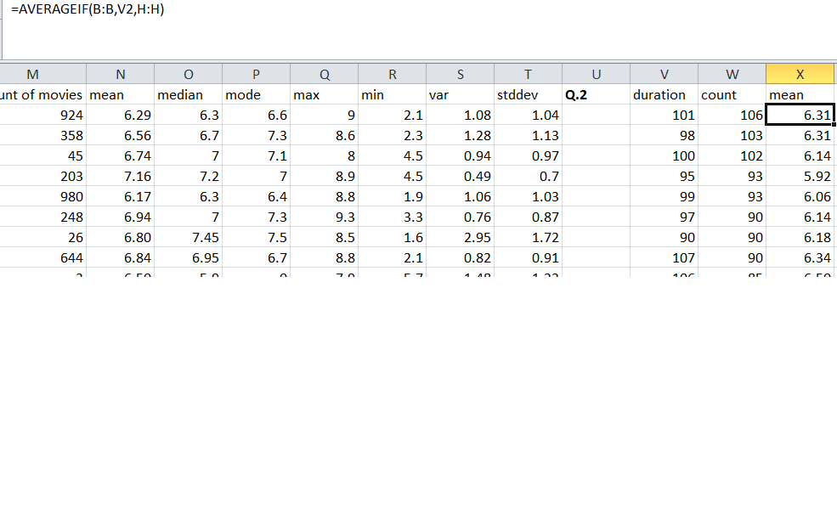
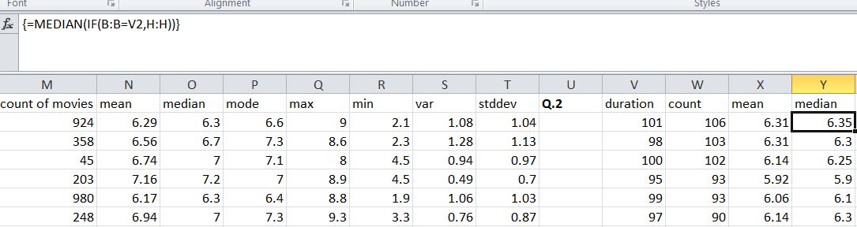
On sorting, I will find the mean, median and standard deviation.

Slide 18
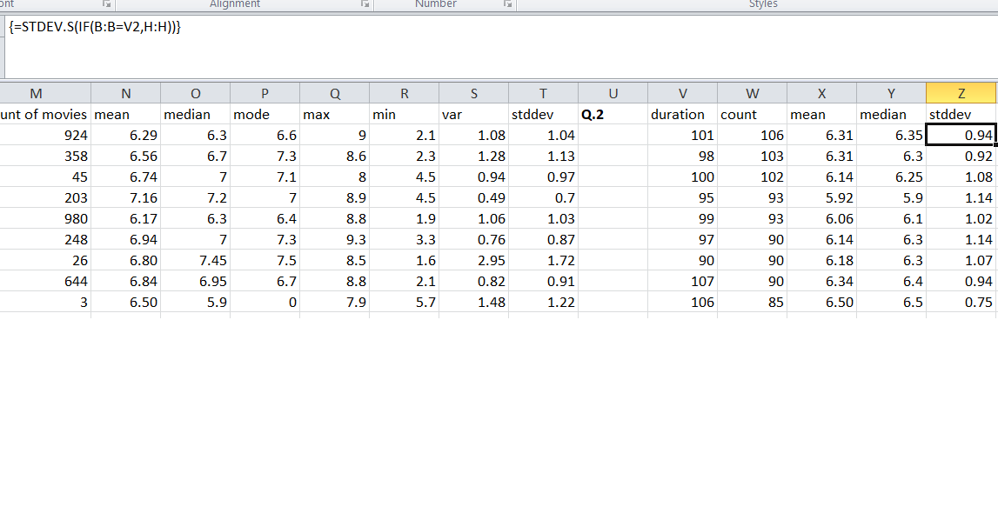
Now I’ll create a scatterplot using insert function and selecting columns: duration and imdb score.
On creation I’ll insert a trend line; a linear trend line on the plot.

Slide 19
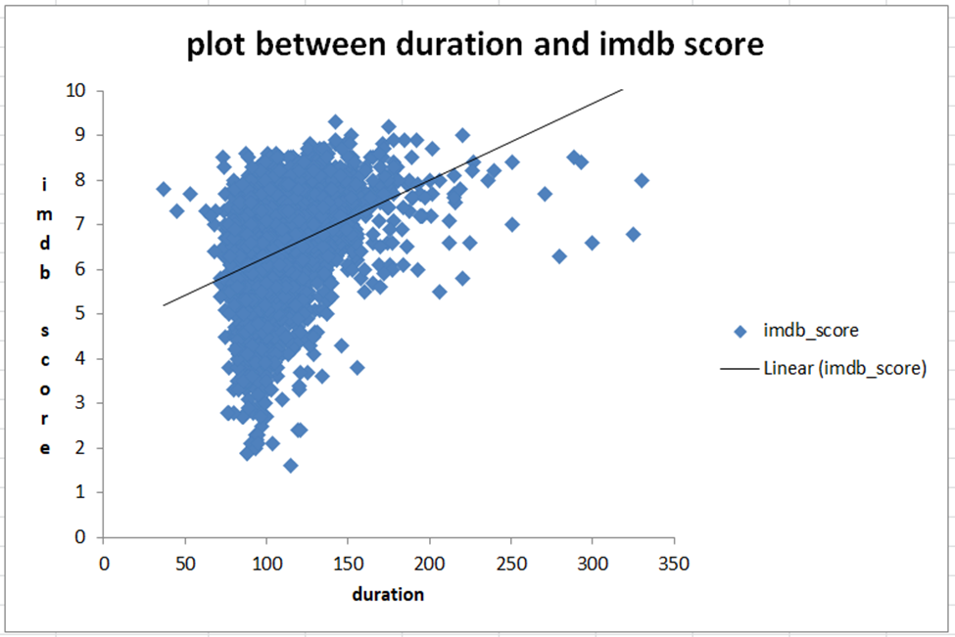

Slide 20
Language Analysis
The task is to determine the most common languages used in movies and analyze their impact on the IMDB score using descriptive statistics.
First to obtain the unique different languages I have used the advanced filter function.
Then count the no of movies under each language using countif.
On getting the total count for each language sort the values from largest to smallest using sorting as done in previous question.

Slide 21
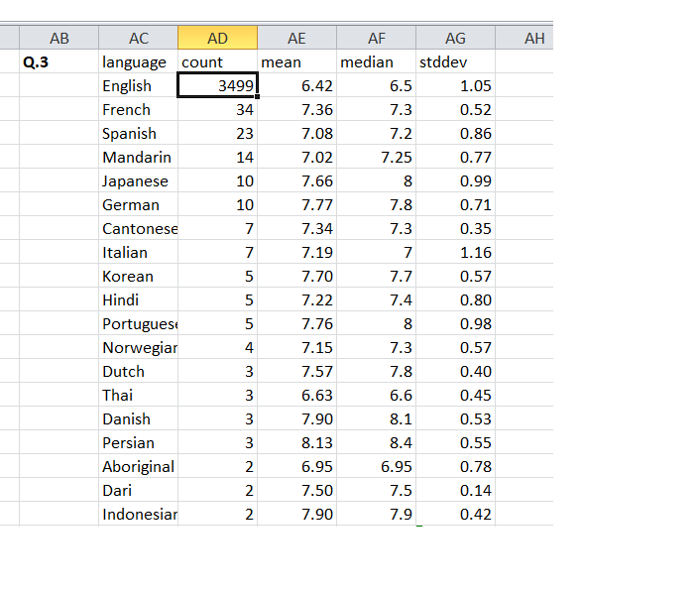
Now we will find mean, median and standard deviation using averageif, {median(if)} and {stdev.s(if)} respectively.

Slide 22
Director Analysis
The task is to identify the top directors based on their average IMDB score and analyze their contribution to the success of movies using percentile calculations.
As done in previous questions I will first identify the unique values using advanced filter option for directors.
On identifying unique values for directors I’ll count the no of movies for each director using countif function.

Slide 23
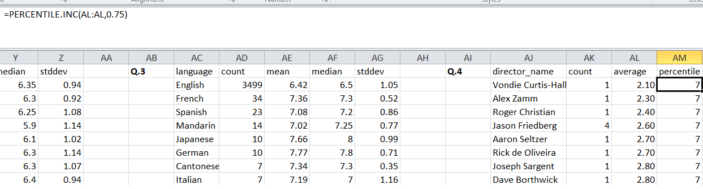
Now I’ll find the average imdb score for each direction using averageif function.
Now sort the mean values in ascending order to obtain the percentile.
I have set the k value as 0.75 to obtain the 75th percentile.

Slide 24
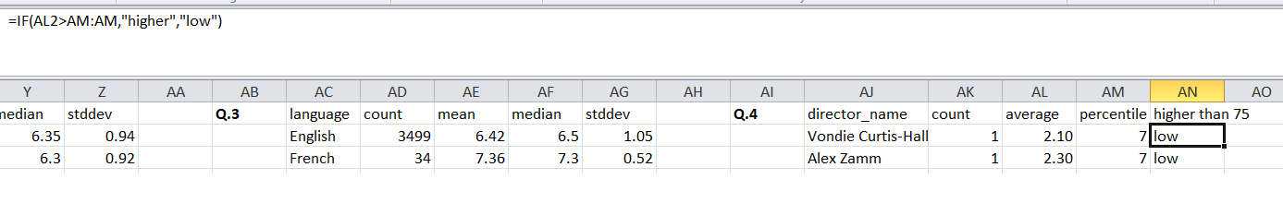
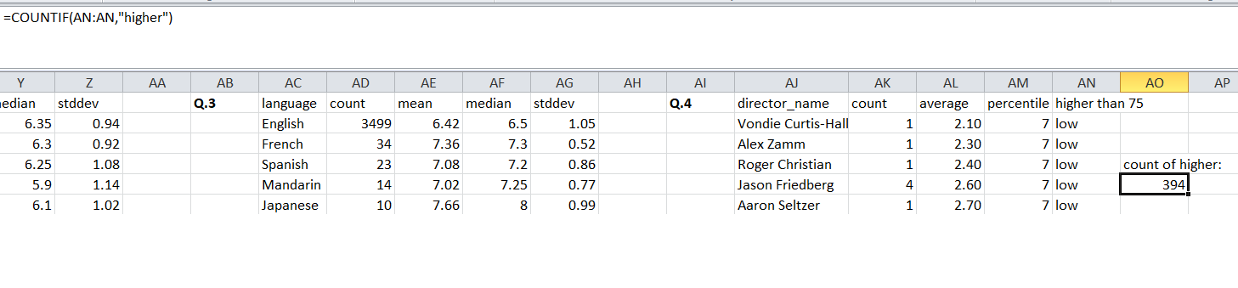
The count of 394 directors have higher value than 75th percentile.

Slide 25
Budget Analysis
The task is to analyze the correlation between movie budgets and gross earnings, and identify the movies with the highest profit margin.
I have created a new column as profit margin by subtracting budget out of gross.

Slide 26
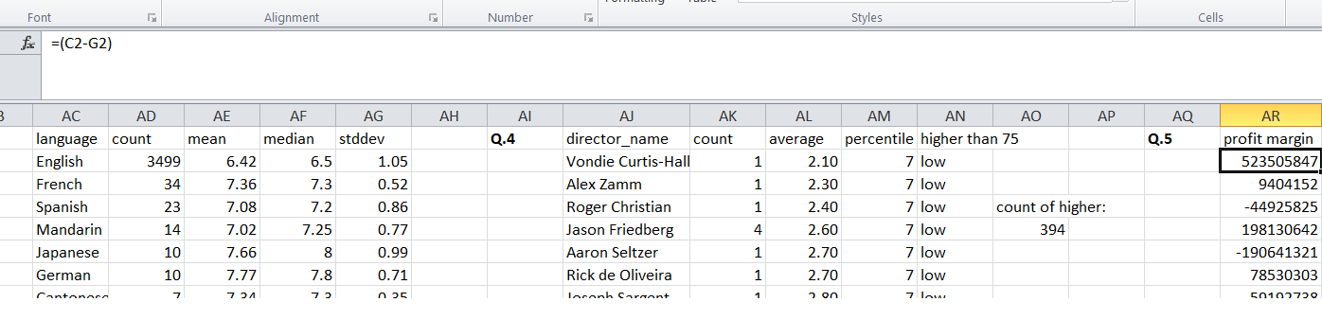
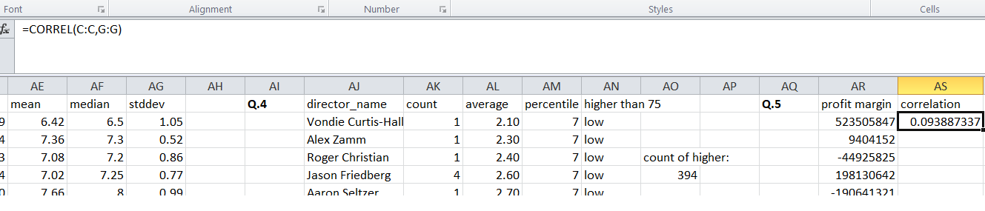
The correlation between budget and gross is obtained using correl function.

Slide 27
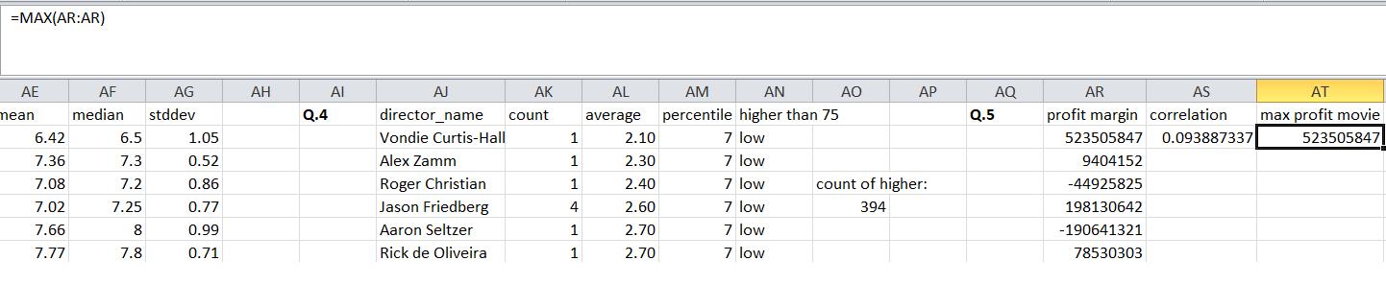
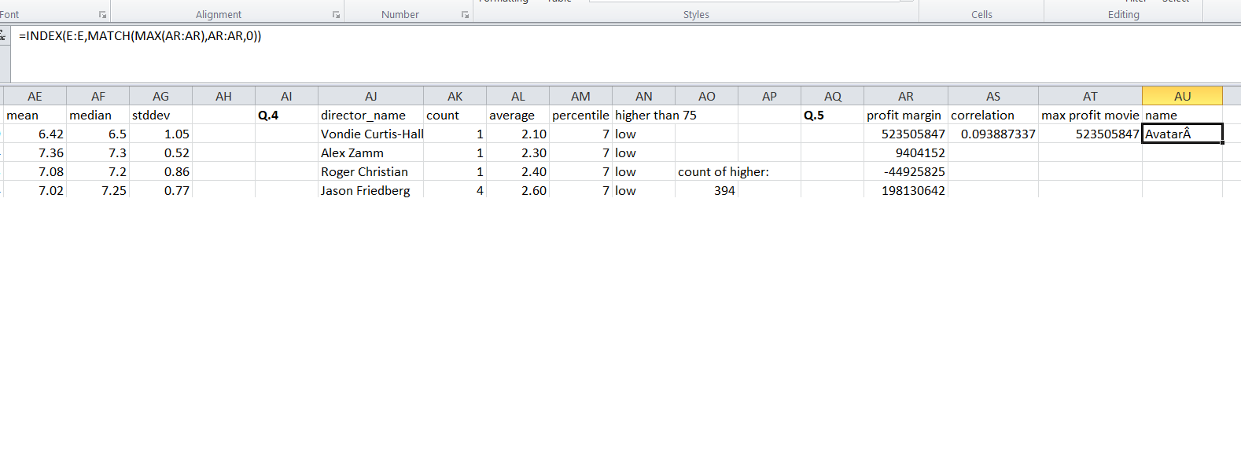
The movie with highest profit is obtained using max and index functions.

Slide 28
Results
The highest no of movies are in comedy genre, followed by action and drama.
The genre comedy have 6.6 as most rated score and the variance of 1.08 and showing 67% to 95% of dispersion.
The most suitable duration for movies is from 90 minutes to 150 minutes.
The most preferred language is English with highest no of movies and mean of 6.42 and median of 6.5 with stddev of 1.05 showing dispersion of 95%.
The count of 394 directors have higher value than 75th percentile.
The highest profitable movie is avatarA with margin of 52,35,05,847.

